Slide 1
The State of Latino USA
Christopher Ackerman-Avila Neighborhood Analysis
Spring 2021

Slide 2
Introduction
Significance of Latinos in the USA
Latinos account for more than half of the population growth in 41% of U.S. counties with at least 1,000 Latinos in 2014… about half are in non-metropolitan areas.
Hispanic people will comprise 56 percent of all new homebuyers by 2030, according to the Urban Institute.
We’re driving growth, therefore, we’re shaping the future of the country
My Motivation
Born and raised in southern California
College in Illinois
Lots of cross-country road trips in between

Slide 3
Overview
Basic Latino Demographics
Opportunity Index, 2019
Opportunity Inequality Index, 2019
Opportunity Trends Index, 2012-2019
Diving into Places of Interest

Slide 4
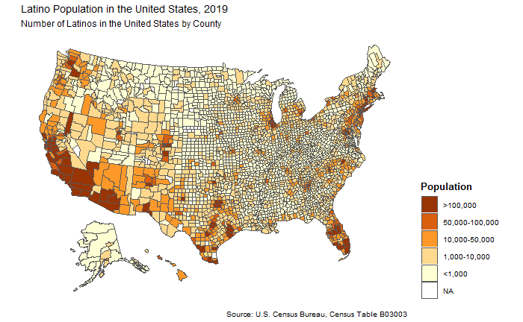
Background

Slide 5
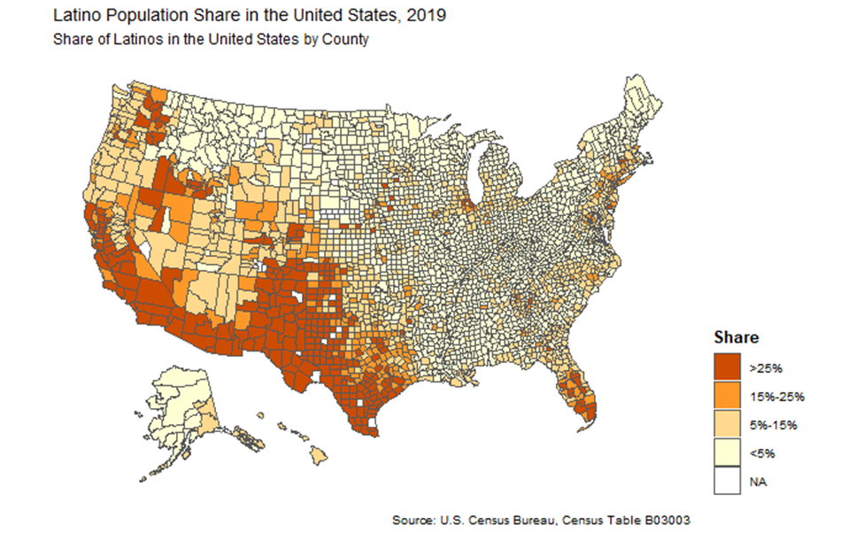
Background

Slide 6
Opportunity Index Variables
The following variables constitute the Opportunity Index.
Education | Health Insurance | Homeownership | Income | Poverty
Share of population with less than a high school degree | Share of population with health insurance coverage | Homeownership rate | Median household income | Share of population below the federal poverty level

Slide 7
Questions Beforehand
What questions do you have about Latinos in the USA?
Where do Latinos enjoy the most opportunity?
Where are inequalities greatest?
Where is the landscape of opportunity improving or deteriorating over time?
In what ways are our assumptions correct or incorrect?

Slide 8
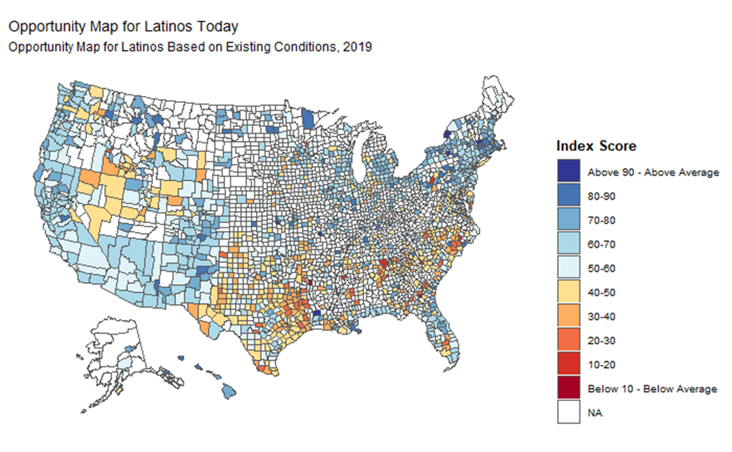
Opportunity Map, 2019

Slide 9
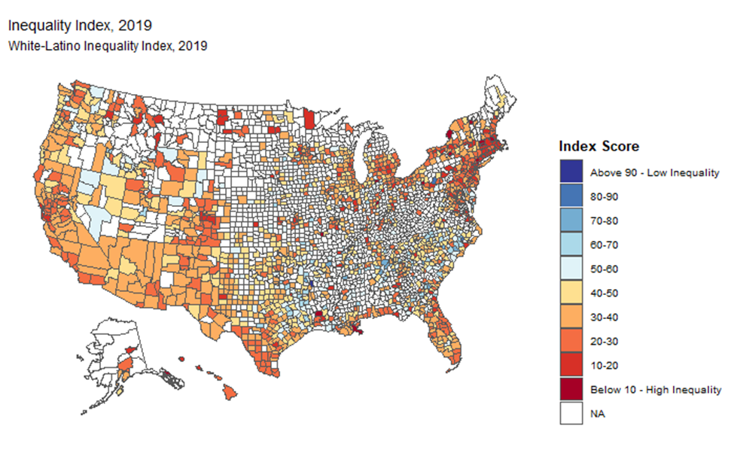
Opportunity Inequality Map, 2019

Slide 10
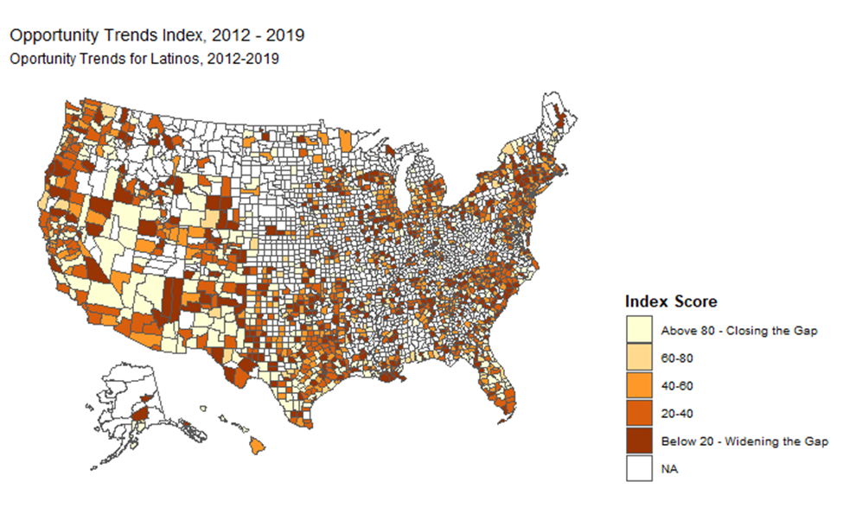
Opportunity Trends, 2012-2019

Slide 11
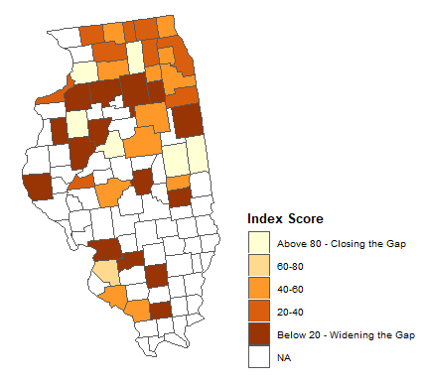
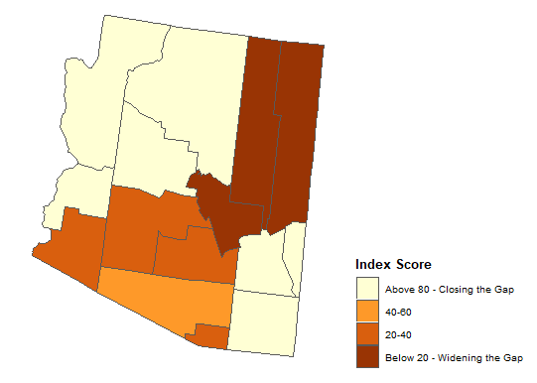
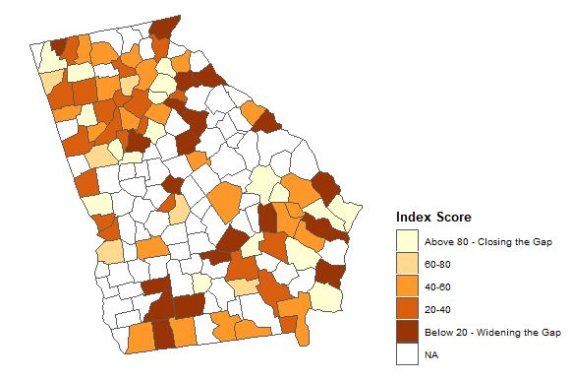
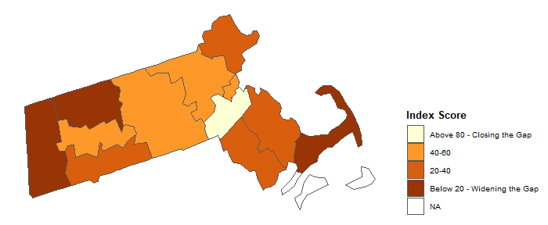
Diving into Places of Interest

Slide 12
Policy Takeaways
Use better tools and processes for targeted policy effects across regions and (non-)metros
Use race- and ethnic-based Opportunity Mapping for policy decision-making
Consider and distinguish opportunity, inequality, and trends
Identify where work needs to be done and start right away where possible (e.g., Northeast)

Slide 13
Resources
Prominent resources used for this research:
Prof. Greenlee’s Lab 17
john powell and Kirwan Institute for the Study of Race and Ethnicity
Harvard Cervantes Observatorio
Pew Research
Economic Research Service at US Department of Agriculture
US Department of Housing and Urban Development

Slide 14
Questions?

Slide 15
Thank you!

